Slide 1


A Body Shape Index at Age 25-64 Predicts Mortality and CHD Hospitalization
Itamar Shafran¹, Nir Y. Krakauer², Jesse C. Krakauer³, Gali Cohen¹, Yariv Gerber¹
1 Department of Epidemiology and Preventive Medicine, School of Public Health, Faculty of Medicine, Tel Aviv University, Tel Aviv, Israel
2 Department of Civil Engineering, City College of New York, New York, NY 10031, USA
3 Associated Physicians/Endocrinology, Berkley, MI 48072, USA
Abstract: 1806

Slide 2
Financial Disclosure
DISCLOSURES FROM PAST 12 MONTHS:
Presenter: Itamar Shafran, MD
Nothing to disclose
Co-author: Nir Y. Krakuer, Phd
Nothing to disclose
Co-author: Jesse C. Krakuer, MD
Nothing to disclose
Co-author: Gali Cohen, PhD
Nothing to disclose
Co-author: Yariv Gerber, PhD
Nothing to disclose
This research was supported in part by the Chief Scientist Office of the Ministry of Health, Israel, and the Israel Science Foundation.
Abstract: 1806
Notes:
Titles on this page are 20 point size. For text, use a font size that is easily readable.
Do not drop below font size 8 and increase font size until the space is full.

Slide 3
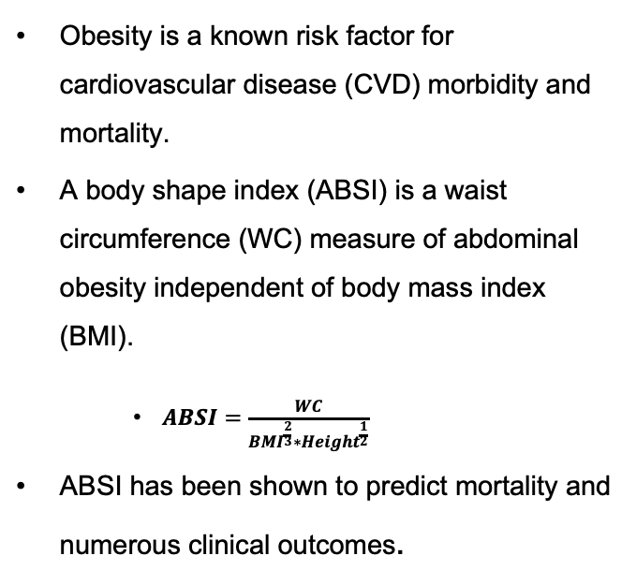
Background
Obesity is a known risk factor for cardiovascular disease (CVD) morbidity and mortality.
A body shape index (ABSI) is a waist circumference (WC) measure of abdominal obesity independent of body mass index (BMI).
$ABSI=\frac{WC}{BMI^{\frac{2}{3}}∗Height^{\frac{1}{2}}}$
ABSI has been shown to predict mortality and numerous clinical outcomes.
Aims: To study the predictive value of ABSI in conjunction with BMI for all-cause mortality and coronary heart disease (CHD) hospitalization among adult participants

Slide 4
Methods and Materials
Participants (n=2,225) were drawn from the First Israeli National Health and Nutrition Survey (1999-2001), constituting adults aged 25-64, representative of the Israeli population.
Baseline anthropometrics, including weight, height, and WC, were measured and expressed as their allometric indices: BMI and ABSI.
Mortality and hospitalization data was retrieved from TIMNA, a Big Data platform created by the Israel Ministry of Health.
Cause of hospitalization was determined according to the primary and secondary reasons, documented in ICD-9 codes.
Follow-up lasted through 2021 for mortality and 2022 for hospitalizations.
Cox regressions assessed the adjusted risk of all-cause mortality and CHD hospitalization, adjusted for socio-demographic and clinical factors.
Notes:
..

Slide 5
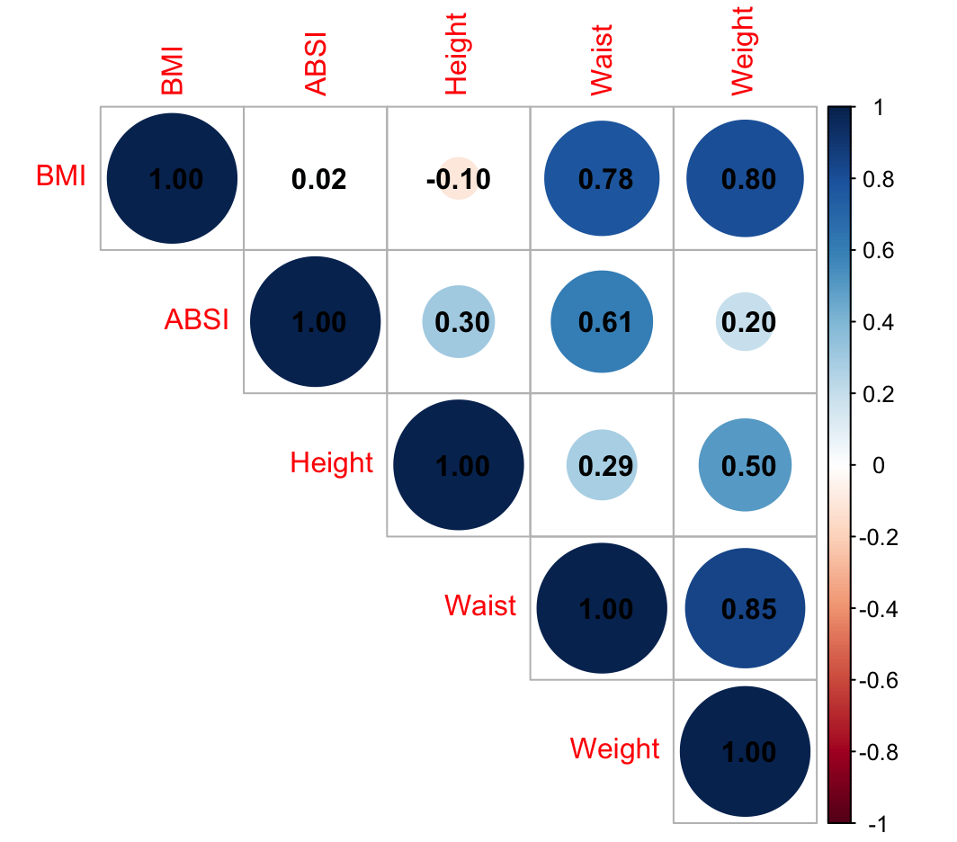
Results
The baseline mean [SD] age was 43 [11] years, and 50% were women.
The correlation between BMI and WC was 0.78, and 0.02 for BMI and ABSI.
Table 1. Baseline characteristics across BMI and ABSI levels
Figure 1. Correlation matrix between anthropometric measures
Notes:
…

Slide 6
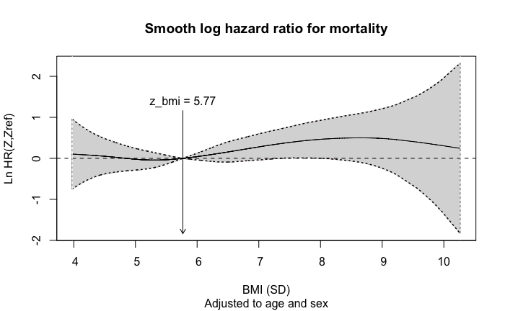
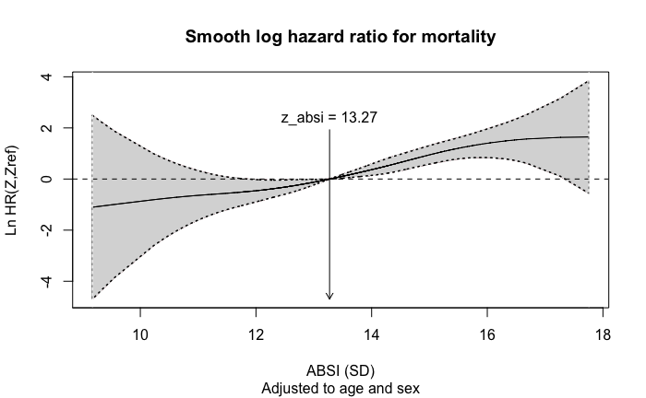
Results – Mortality
Over a median follow-up of 21 years, 247 (11.1%) deaths occurred.
The multivariable-adjusted hazard ratios (HRs) for mortality per 1 SD increase were:
BMI: 1.11 (95% CI: 0.97; 1.27)
ABSI: 1.55 (95% CI: 1.33; 1.79)
Log HR plotted against SD units and adjusted for age & sex
Reference line set to mean SD value
Table 2. Hazard ratios for all-cause mortality per 1 SD increase in BMI and ABSI
 | Age and Sex | + Classic Risk Factors | + Anthropometrics
BMI | 1.14 (1.01-1.30) | 1.09 (0.95-1.25) | 1.11 (0.97-1.27)
ABSI | 1.61 (1.39-1.86) | 1.54 (1.33-1.78) | 1.55 (1.33-1.79)
HRs are reported per 1 SD increase (4.666 for BMI; 0.005 for ABSI). Classic risk factors: hypertension, hyperlipidemia, diabetes, and smoking status. ABSI – a body shape index; BMI – body mass index.
ABSI exhibited a significant association with mortality risk across all standard BMI categories
Adjusted for demographics and classic CVD risk factors, the HRs (95% CIs) per 1 SD increase in ABSI were 1.38 (1.01; 1.88) for individuals with a BMI of 18.5-24.9, 1.70 (1.34; 2.16) for BMI 25.0-29.9, and 1.46 (1.13; 1.87) for BMI ≥30.0.
Notes:
…

Slide 7
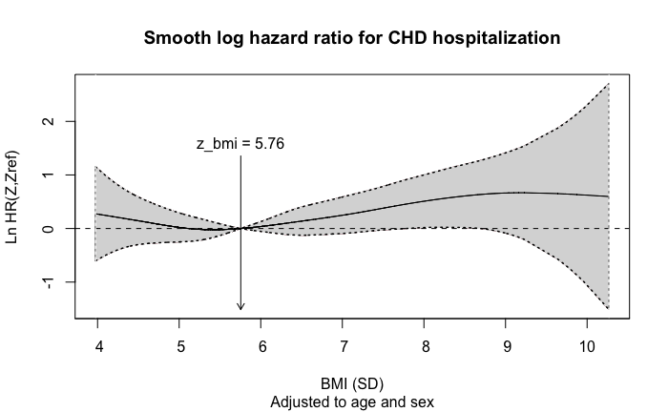
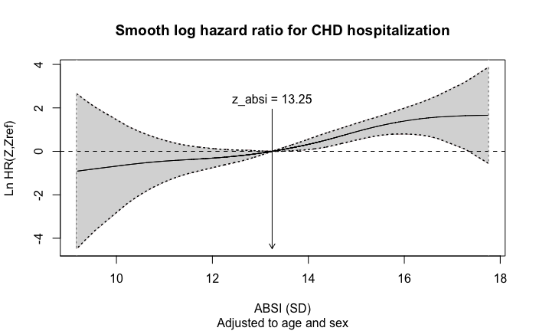
Results – CHD Hospitalizations
Among CVD-free participants at baseline (n=2,146), 267 (12.4%) were hospitalized for CHD during follow-up.
Hospitalized participants had higher ABSI (0.082 vs. 0.078, P<.001) and BMI (28.3 vs. 26.7, P<.001) than individuals who remained free of CHD hospitalizations.
An increase in the adjusted HR was seen for both ABSI [1.34 (95% CI: 1.15; 1.55)] and BMI [1.16 (95% CI: 1.01; 1.33)].
Log HR plotted against SD units and adjusted for age & sex
Reference line set to mean SD value
Table 3. Hazard ratios for CHD hospitalization per 1 SD increase in BMI and ABSI
 | Age and Sex | + Classic Risk Factors | + Anthropometrics
BMI | 1.22 (1.07-1.38) | 1.15 (1.01-1.32) | 1.16 (1.01-1.33)
ABSI | 1.35 (1.17-1.56) | 1.33 (1.15-1.55) | 1.34 (1.15-1.55)
HRs are reported per 1 SD increase (4.666 for BMI; 0.005 for ABSI). Classic risk factors: hypertension, hyperlipidemia, diabetes, and smoking status. ABSI – a body shape index; BMI – body mass index; CHD – coronary heart disease.
Notes:
…

Slide 8
Conclusions
In a 20-year prospective study of a middle-aged cohort, baseline ABSI was a stronger predictor of mortality and CHD hospitalizations than BMI.
ABSI was independent of BMI as a predictor for mortality and hospitalizations.
Further research is warranted to better understand the predictive value of ABSI, and to compare it to other obesity measurements.
Notes:
…

